Slide 1
Discrete Controller Design
Discrete equivalent design example
Direct design in the z-plane
  Desired closed-loop pole locations in the z-plane
  Example

Slide 2
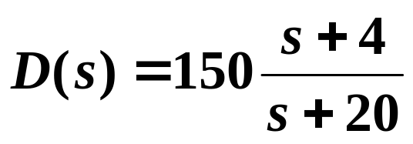

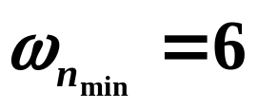
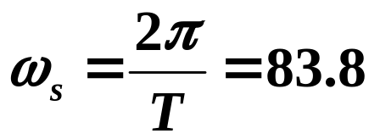
What is the “equivalent” discrete design?
Use zero-pole mapping with T = 0.075 sec.
How many samples per rise time?
rad/s
rad/s
rad/s

Slide 3
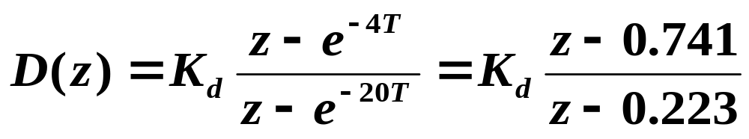







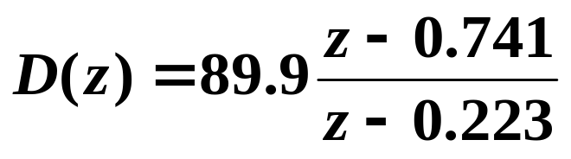
Match DC gains:
T = 0.075 sec.
For T = 0.075 sec.:

Slide 4













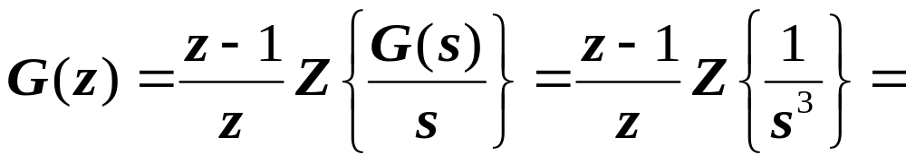
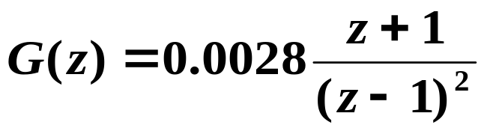
How does sampled-data system perform?
Σ
ZOH
Σ
For T = 0.075 sec.:

Slide 5
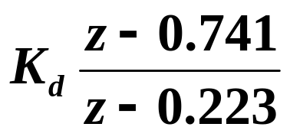
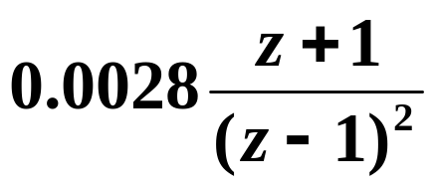
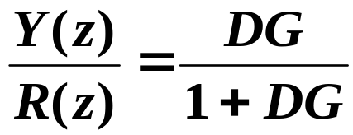
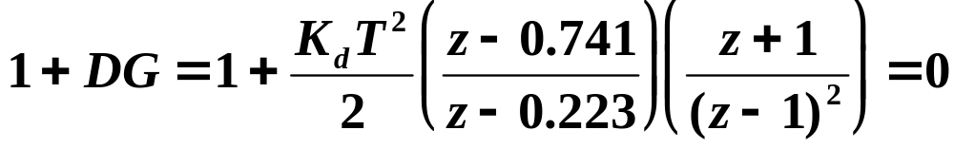
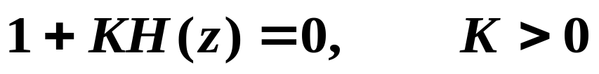
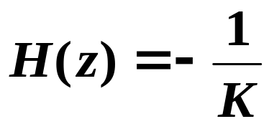
How is Root Locus drawn in z-plane?
Σ

Slide 6
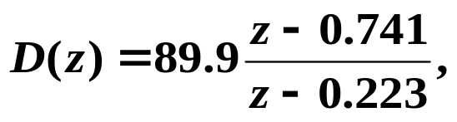

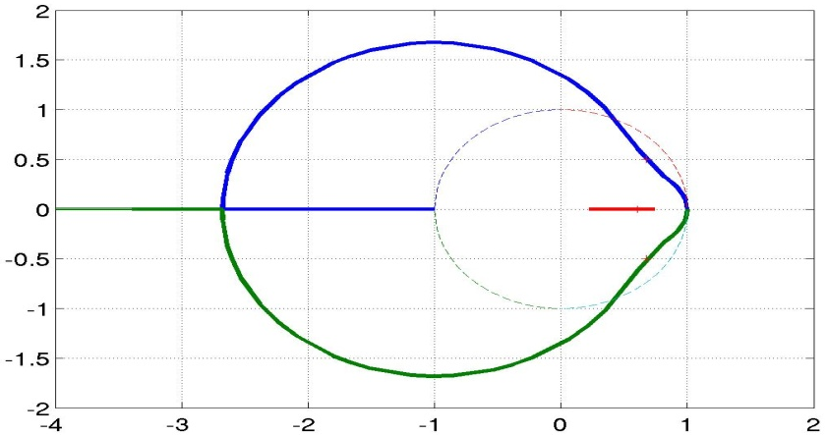
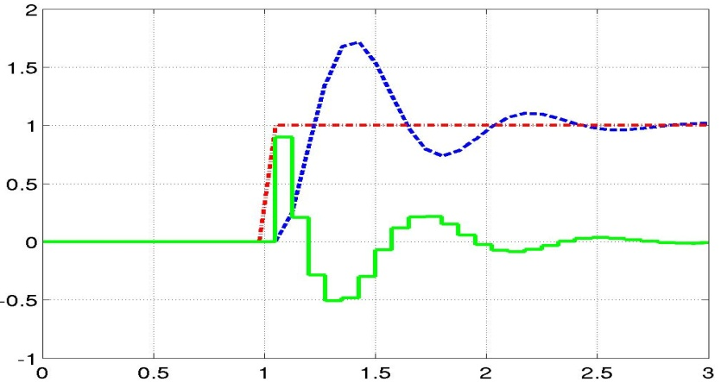
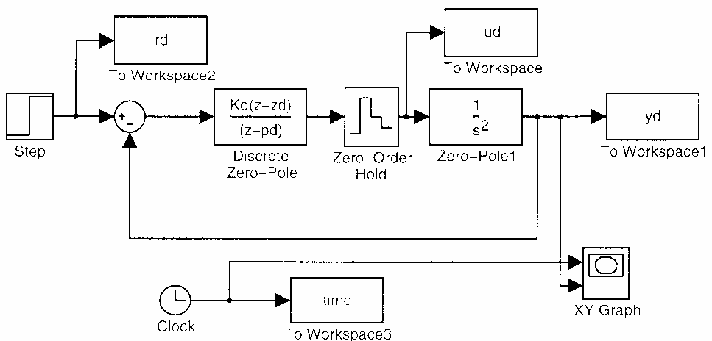



Input r_{d}
Control u_{d} / 100
Output y_{d}
Im(z)
r_{d}, u_{d} / 100, y_{d}
Re(z)
Time (seconds)
Useful MATLAB
command: stairs

Slide 7
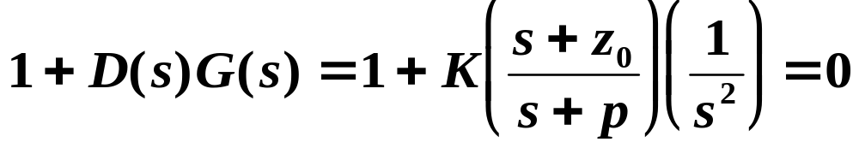
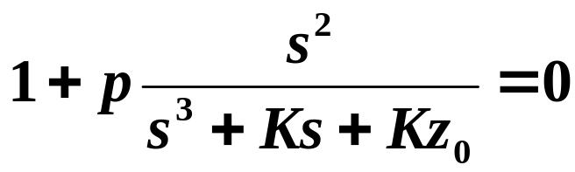
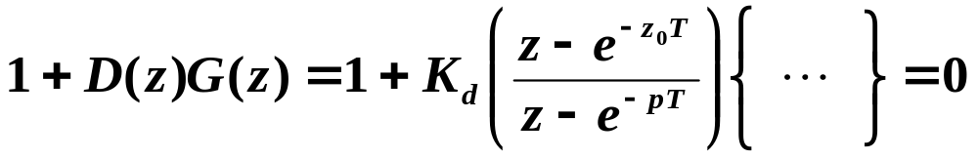
Further Comments on Root Locus
Continuous-time design:
Fix K and z₀ , and plot root locus vs. pole location p:
But for discrete equivalent design using pole-zero mapping:
Difficult to plot root locus vs. p or z₀ .
Equation nonlinear in p and z₀ .

Slide 8

Direct Design in the z-Plane
Want to select the desired closed-loop poles of the system in the z-plane.
Then design D(z) so the actual closed-loop poles are (approximately) at the desired locations.
To keep D(z) causal, its denominator polynomial should be of equal or higher order than its numerator polynomial.

Slide 9
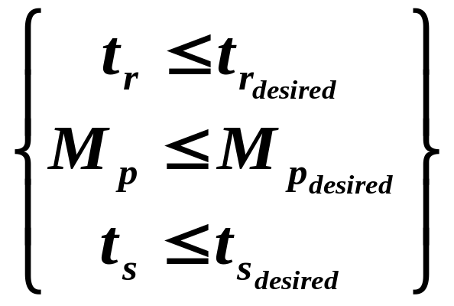
what is the desired region in the z-plane for the closed-loop poles of the system?
For
In the s-plane:
Im(s)
Re(s)

Slide 10
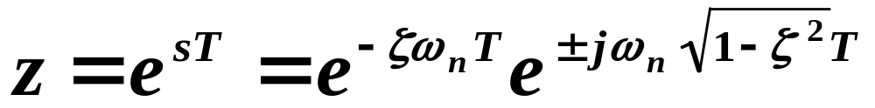
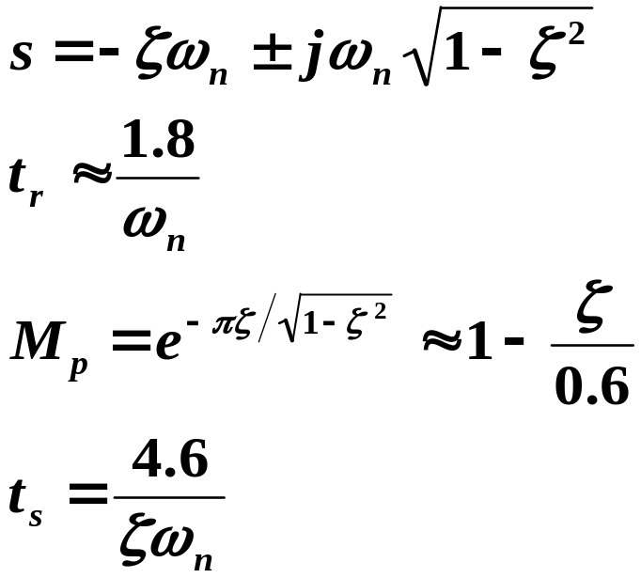
Convert desired regions in the s-plane to those in the z-plane using the mapping:
Im(z)
In the s-plane:
Re(z)
1
Im(z)
Im(z)
Re(z)
Re(z)
1
1
See Figure 4.24 of text.

Slide 11
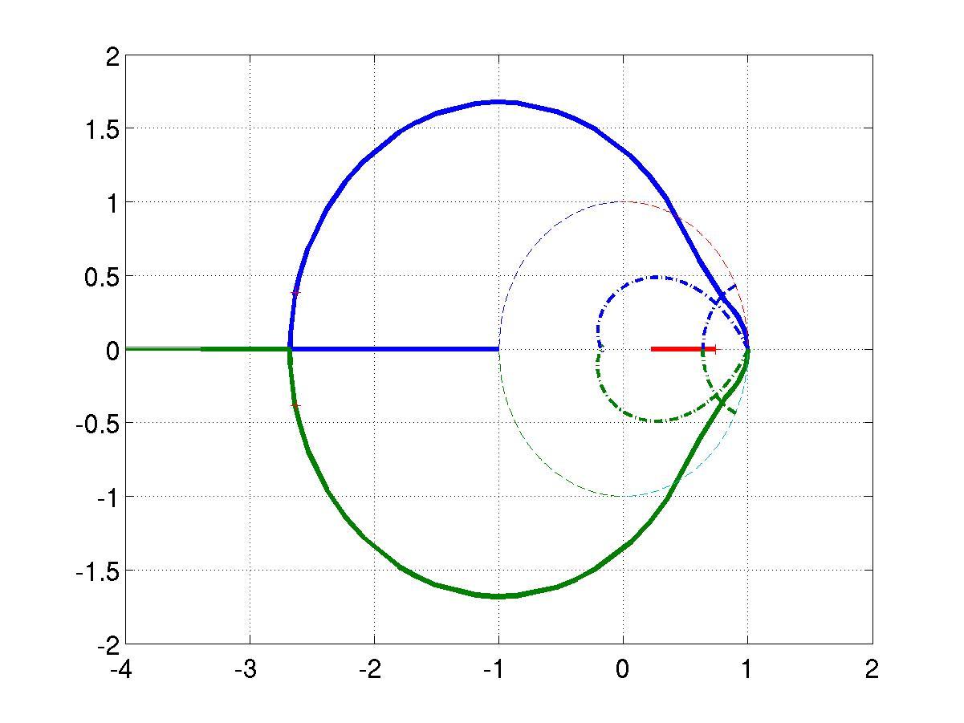
Combining performance specifications on rise time, overshoot, and settling time:
Im(z)
Re(z)
1
Taking another look at our discrete equivalent design in the example earlier:
Im(z)
Re(z)

Slide 12
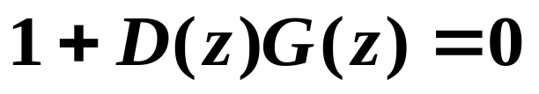
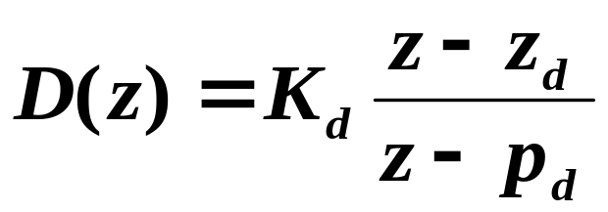
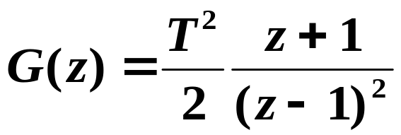
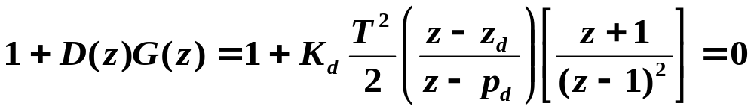
Direct Design in z-Plane:
Σ

Slide 13
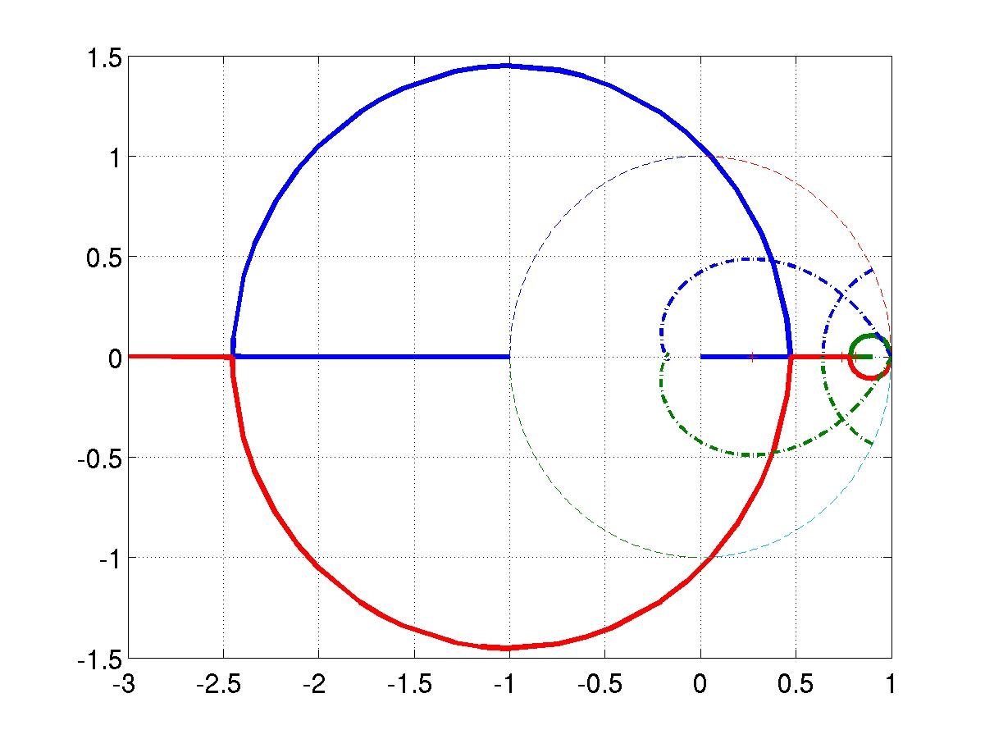

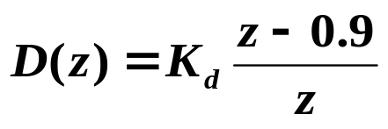
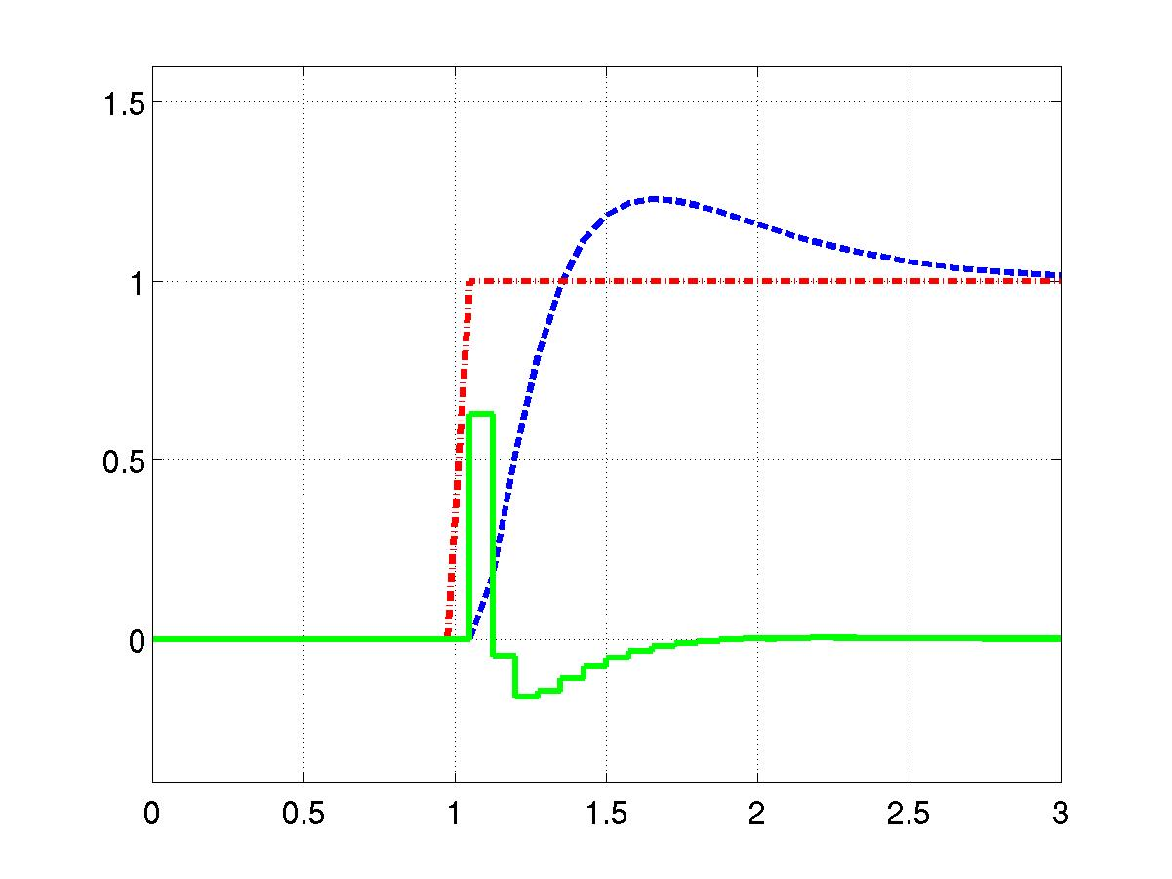



Im(z)
Re(z)
Input r_{d}
Control u_{d} / 100
r_{d}, u_{d} / 100, y_{d}
Output y_{d}
Time (seconds)

Slide 14
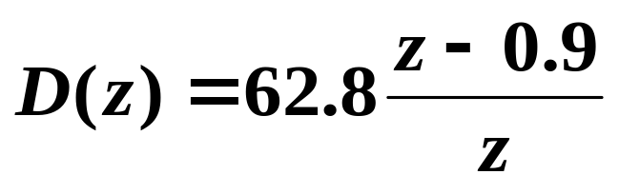
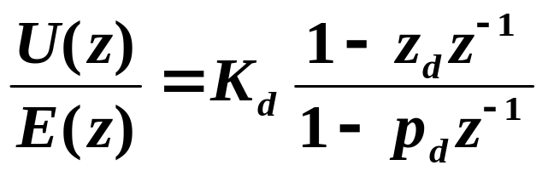
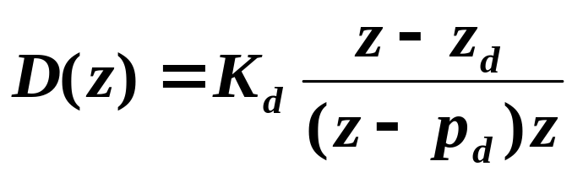
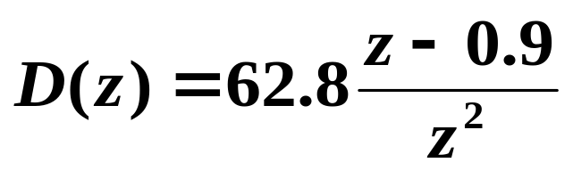
In practice, sometimes need to add a delay:

Slide 15
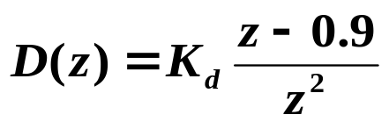
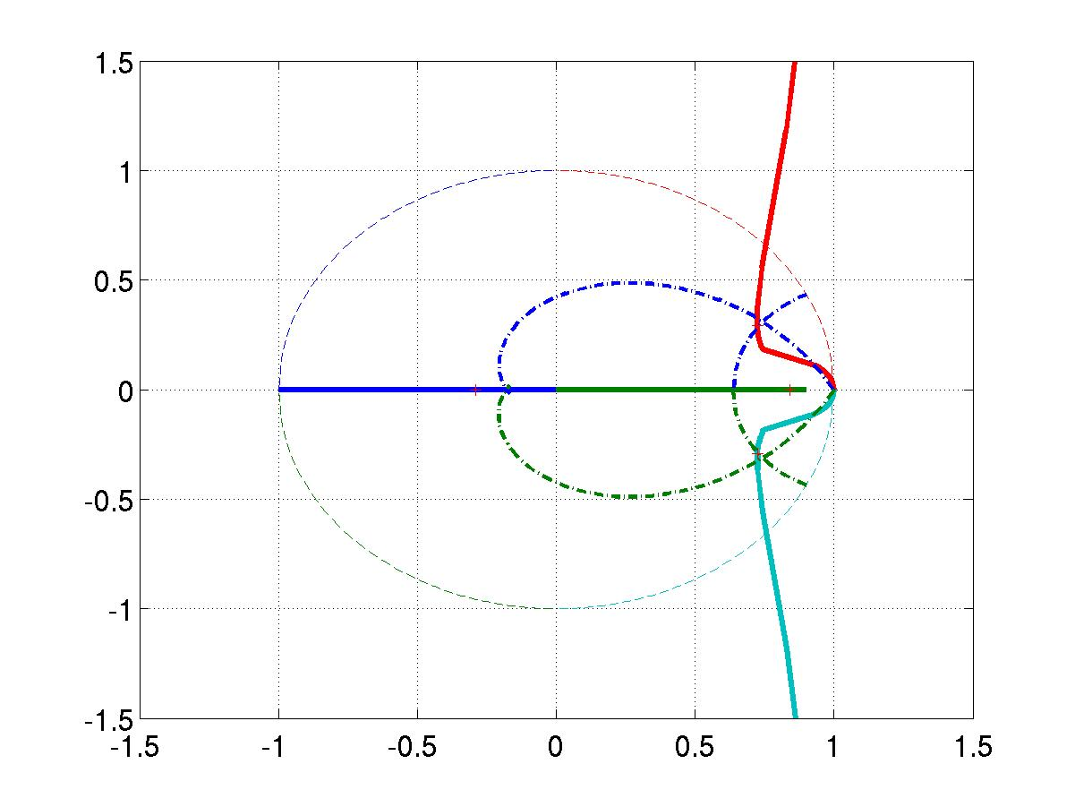
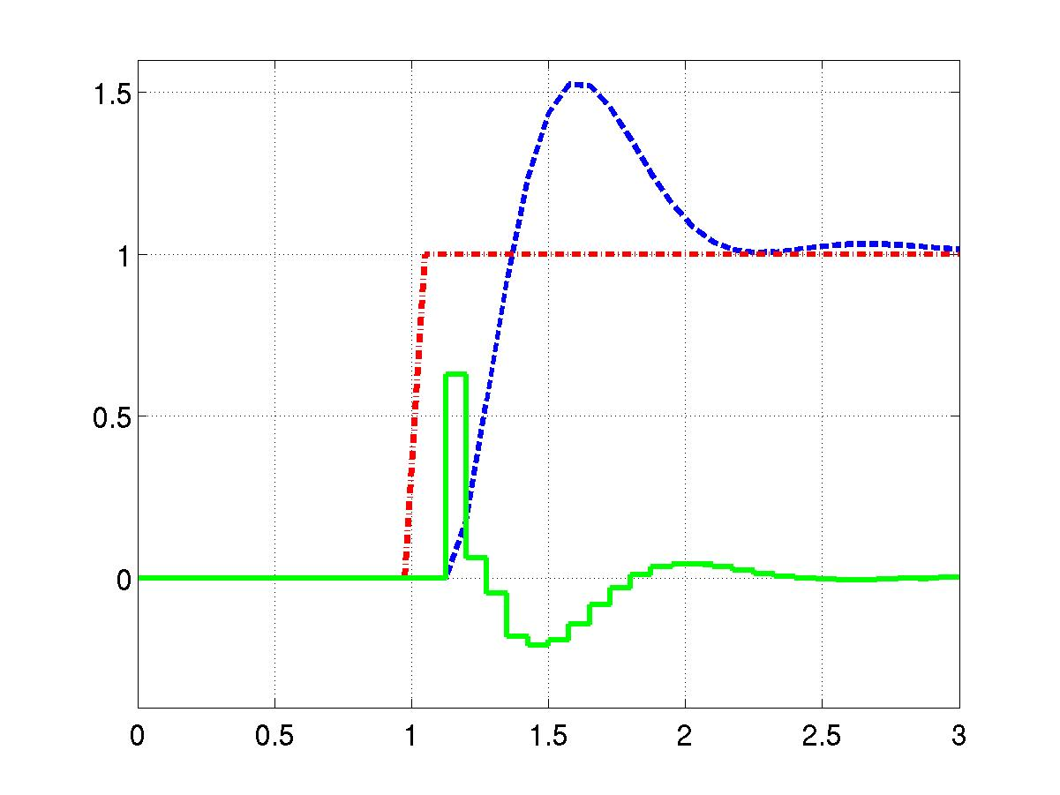

Im(z)
Re(z)
Input r_{d}
Control u_{d} / 100
r_{d}, u_{d} / 100, y_{d}
Output y_{d}
Time (seconds)

Slide 16
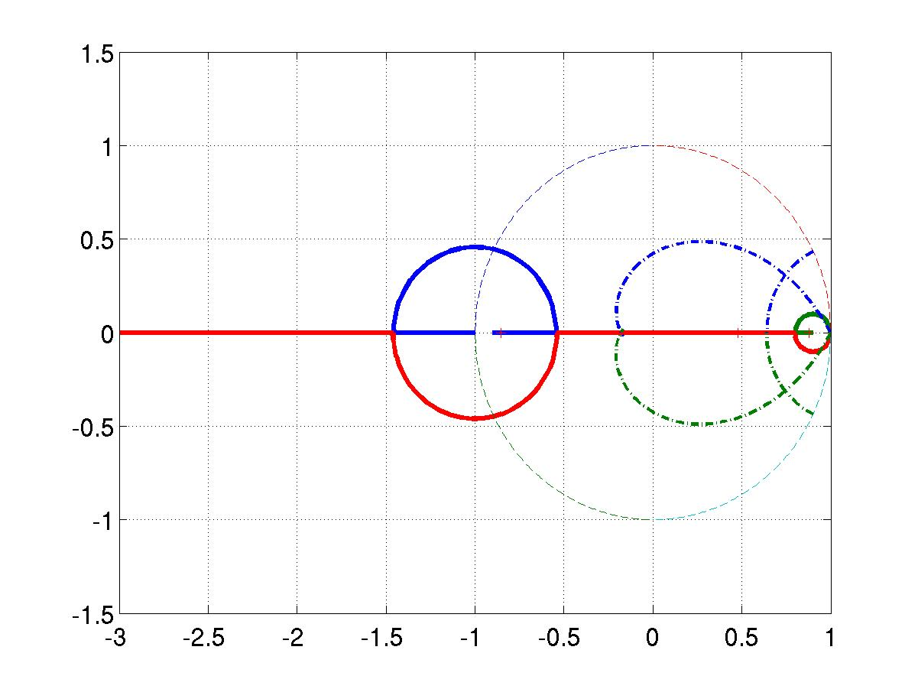

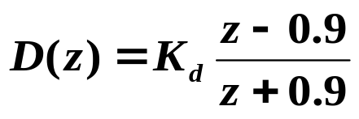
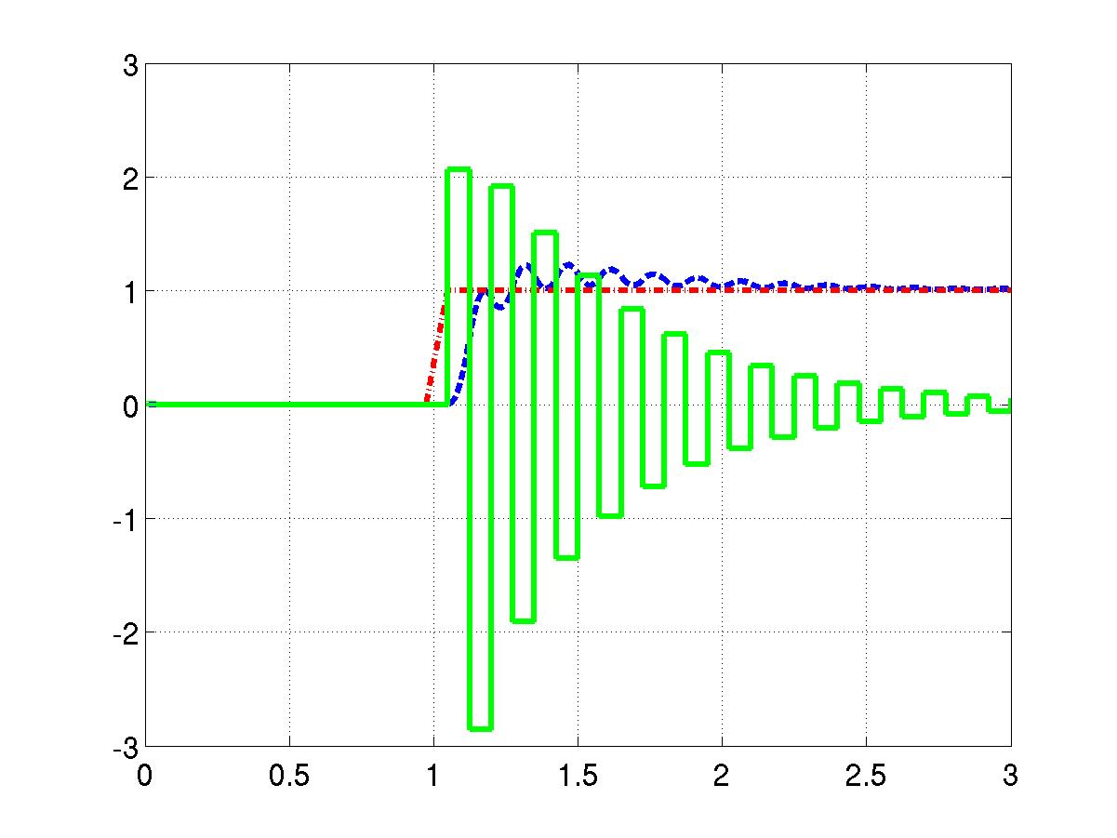


Im(z)
Re(z)
Input r_{d}
Control u_{d} / 100
Output y_{d}
r_{d}, u_{d} / 100, y_{d}
Time (seconds)

